Slide 1
Unit Testing
Unit 3
Software Quality Assurance

Slide 2
Unit Testing
It is a method by which individual units of source code are tested to determine if they are fit for use.
A unit is the smallest testable part of an application like functions/procedures, classes, interfaces.
Unit test are typically written and run by s/w developers to ensure that code meets its design and behaves as intended.
The goal of UT is to isolate each part of the program and show that the individual parts are correct.
It provides a strict, written contract that the piece of code must satisfy.
As a result, it affords several benefits
UT finds problems early in the development cycle.

Slide 3
Unit Test Procedures
Each test case should be combined with a set of expected results
Because a component is not a stand alone program, driver and/or stub s/w must be developed for each unit test.
A driver is nothing more that a “main program” that accepts test case data, passes such data to the component and prints relevant results.
Stubs replace modules that are subordinate the component to be tested.
A stub(Dummy Program) uses the subordinates modules interface, my do minimal data manipulation, prints verification of entry, and returns control to the module undergoing testing.

Slide 4
Boundary Value Testing
In ST the Boundary Value Testing is a black box test design technique based on test cases.
Input domain testing is also known as “BVT” is the best-known best-specification testing technique.
Normal BVT is concerned only with valid value of the input variables.
Robust boundary value testing considers invalid and valid variable values.

Slide 5
Advantages of Boundary Value Testing
The BVA technique of testing is quite easy to use and remember because of the uniformity of identified tests and the automated nature of this technique.
One can easily control the expenses made on the testing by controlling the number of identified test cases. This can be done with respect to the demand of the software that needs to be tested.
BVA is the best approach in cases where the functionality of a software is based on numerous variables representing physical quantities.
The technique is best at revealing any potential UI or user input troubles in the software.
The procedure and guidelines are crystal clear and easy when it comes to determining the test cases through BVA.
The test cases generated through BVA are very small.

Slide 6
Disadvantages of Boundary Value Testing
This technique sometimes fails to test all the potential input values. And so, the results are unsure.
The dependencies with BVA are not tested between two inputs.
This technique doesn’t fit well when it comes to Boolean Variables.
It only works well with independent variables that depict quantity.

Slide 7
Types of Boundary Value Testing
Normal Boundary Value Testing
Robust Boundary Value Testing
Worst-case Boundary Value Testing
Robust Worst-case Boundary Value Testing

Slide 8
Normal Boundary Value Testing
Normal Boundary value analysis is a black-box testing technique, closely associated with equivalence class partitioning.
In this technique, we analyze the behavior of the application with test data residing at the boundary values of the equivalence classes.
The basic idea in boundary value testing is to select input variable values at their:
Minimum
Just above the minimum
A nominal value
Just below the maximum
Maximum

Slide 9
Advantages of boundary value analysis
It is easier and faster to find defects as the density of defects at boundaries is more.
The overall test execution time reduces as the number of test data greatly reduces.

Slide 10
Disadvantages of boundary value analysis
The success of the testing using boundary value analysis depends on the equivalence classes identified, which further depends on the expertise of the tester and his knowldege of application. Hence, incorrect identification of equivalence classes leads to incorrect boundary vlaue testing.
For application with open boundaries or application not having one dimensional boundaries are not suitable for boundary value analysis. In those cases, other black-box techniques like "Domain Analysis" are used.

Slide 11
Robust Boundary Value Testing
Robust BVT technique like BVT technique , but this technique is extend negative case in boundary and still focus on Mind, Mid and Max.
In this technique s/w is tested by giving invalid input or data.
Robustness testing is usually done to test exception handling.
In this techniques we make combinations in such a way that some of the invalid values are also tested as input.

Slide 12
Worst-case Boundary Value Testing
Boundary Value analysis uses the critical fault assumption and therefore only tests for a single variable at a time assuming its extreme values.
By disregarding this assumption we are able to test the outcome if more than one variable were to assume its extreme value.
In an electronic circuit this is called Worst Case Analysis.
In Worst-Case testing we use this idea to create test cases.

Slide 13
Robust Worst-case Boundary Value Testing
If the function under test were to be of the greatest importance we could use a method named Robust Worst-Case testing which as the name suggests draws it attributes from Robust and Worst-Case testing.
for increase more and more chance to find defect, the testing add +1 in max and -1 in min.
Focus on worst-case robust boundary of the input space to identify test cases.
Obviously this results in the largest set of test results we have seen so far and requires the most effort to produce.

Slide 14
Special Value Testing
Special Value is defined and applied form of Functional Testing, which is a type of testing that verifies whether each function of the software application operates in conformance with the required specification.
Special value testing is probably the most extensively practiced form of functional testing which is most intuitive and least uniform.
This technique is performed by experienced professionals who are experts in this field and have profound knowledge about the test and data required for it.
They continuously participate and apply tremendous efforts to deliver appropriate test results to suit the client’s requested demand.

Slide 15
Why Special Value Testing
The testing executed by Special Value Testing technique is based on past experiences, which validates that no bugs or defects are left undetected.
The testers are extremely knowledgeable about the industry and use this information while performing Special Value Testing.
Another benefits of opting Special Value Testing technique is that it is ad-hoc in nature
There are no guidelines used by the testers other that their “Best engineering judgment”.
The most important aspect of this testing is that, it has had some very valuable inputs and success in finding bugs and errors while testing a software.

Slide 16
Random Testing
Random testing is a black-box software testing technique where programs are tested by generating random, independent inputs.
Results of the output are compared against software specifications to verify that the test output is pass or fail.
In case of absence of specifications the exceptions of the language are used which means if an exception arises during test execution then it means there is a fault in the program, it is also used as way to avoid biased testing.
andom testing is performed where the defects are NOT identified in regular intervals.
Random input is used to test the system's reliability and performance.
Saves time and effort than actual test efforts.
Other Testing methods Cannot be used to.

Slide 17
Monkey Testing
Monkey testing is a software testing technique in which the testing is performed on the system under test randomly.
In Monkey Testing the tester (sometimes developer too) is considered as the 'Monkey'
If a monkey uses a computer he will randomly perform any task on the system out of his understanding
Just like the tester will apply random test cases on the system under test to find bugs/errors without predefining any test case
In some cases, Monkey Testing is dedicated to unit testing This testing is so random that the tester may not be able to reproduce the error/defect.
The scenario may NOT be definable and may NOT be the correct business case.
Monkey Testing needs testers with very good domain and technical expertise.

Slide 18
The advantages of Monkey testing:
As the scenarios that are tested are adhoc, system might be under stress so that we can also check for the server responses.
This testing is adopted to complete the testing, in particular if there is a resource/time crunch.

Slide 19
The Disadvantages of Monkey testing
No bug can be reproduced: As tester performs tests randomly with random data reproducing any bug or error may not be possible.
Less Accuracy: Tester cannot define exact test scenario and even cannot guarantee the accuracy of test cases
Requires very good technical expertise: It is not worth always to compromise with accuracy, so to make test cases more accurate testers must have good technical knowledge of the domain
Fewer bugs and time consuming: This testing can go longer as there is no predefined tests and can find less number of bugs which may cause loopholes in the system

Slide 20
Equivalence Class Testing
Equivalence Partitioning also called as equivalence class partitioning.
It is abbreviated as ECP.
This technique used by the team of testers for grouping and partitioning of the test input data, which is then used for the purpose of testing the software product into a number of different classes.
It is a software testing technique that divides the input test data of the application under test into each partition at least once of equivalent data from which test cases can be derived.
An advantage of this approach is it reduces the time required for performing testing of a software due to less number of test cases.

Slide 21
Guidelines for Equivalence Class Testing:
By following a set of guidelines while implementing the process of testing, the team of testers can ensure better outputs from the tests and make sure all scenarios are being tested accurately. Therefore, listed below are some tips/guidelines for equivalence class testing:
Use robust forms if the error conditions in the software product are of high priority.
It can be used by the team in projects where the program function is complex.
To ensure the accuracy and precision of equivalence class testing, define the input data in terms of intervals and sets of discrete values.
Use of robust from is redundant of the implemented language is strongly types and when invalid values cause runtime errors in the system.
The team needs to select one valid and one invalid input value each, if the input conditions are broken or not stated accurately.
Establishing proper equivalence relation might require several tries and extra efforts of the team.

Slide 22
Advantages Equivalence Class Testing
It helps reduce the number of test cases, without compromising the test coverage.
Reduces the overall test execution time as it minimizes the set of test data
It can be applied to all levels of testing, such as unit testing, integration testing, system testing etc.
Enables the testers to focus on smaller data sets, which increases the probability to uncovering more defects in the software product.
It is used in cses where performing exhaustive testing is difficult but at the same time maintaining good coverage is required.

Slide 23
Disadvantages Equivalence Testing
It does not consider the conditions for boundary value.
The identification of equivalence classes relies heavily on the expertise of testers.
Testers might assume that the o/p for all i/p data set are correct, which can become a great hurdle in testing.

Slide 24
Traditional Equivalence Class Testing
Programmer arrogance: – in the 1960s and 1970s, programmers often had very detailed input data requirements. – if input data didn’t comply, it was the user’s fault – the popular phrase—Garbage In, Garbage Out (GIGO)
• Programs from this era soon developed defences – (many of these programs are STILL legacy software) – as much as 75% of code verified input formats and values
• “Traditional” equivalence class testing focuses on detecting invalid input. – (almost the same as our “weak robust equivalence class testing”)

Slide 25
Types of Equivalence Class Testing
Weak normal equivalence class testing: Uses one valid input variable from every single equivalence class for a test case & follows the single fault assumption
Strong normal equivalence class testing: Uses the Cartesian product of the equivalence classes of each valid input variables to obtain the test case & follows the multiple fault assumption
Weak robust equivalence class testing: Defines equivalence class in terms of the class of valid inputs & class of invalid inputs for test case.
Strong robust equivalence class testing: Uses every single element of Cartesian product of all the equivalence classes to acquire test cases.

Slide 26
Strong Normal Equivalence Class Testing
• Identify equivalence classes of valid values.
• Test cases from Cartesian Product of valid values.
• Detects faults due to interactions with valid values of any number of variables.
• OK for regression testing, better for progression testing.

Slide 27
Weak Robust Equivalence Class Testing
• Identify equivalence classes of valid and invalid values.
• Test cases have all valid values except one invalid value.
• Detects faults due to calculations with valid values of a single variable.
• Detects faults due to invalid values of a single variable.
• OK for regression testing

Slide 28
Weak Normal Equivalence Class Testing
• Identify equivalence classes of valid values.
• Test cases have all valid values.
• Detects faults due to calculations with valid values of a single variable.
• OK for regression testing.
• Need an expanded set of valid classes

Slide 29
Strong Normal Equivalence Class Testing
• Identify equivalence classes of valid values.
• Test cases from Cartesian Product of valid values.
• Detects faults due to interactions with valid values of any number of variables.
• OK for regression testing, better for progression testing.

Slide 30
Improved Equivalence Class Testing
There are two main properties that underpin the methods used in functional testing.
These two properties lead to two different types of equivalence class testing, weak and strong.
However if one decide to test for invalid i/p or o/p as well as valid i/p or o/p we can produce another two different types of equivalence class testing, normal and robust.
Robust equivalence class testing takes into consideration the testing of invalid values, whereas normal does not.

Slide 31
Edge Testing
A hybrid of BVT and Equivalence Class Testing forms the name “Edge Testing.”
It is used when contiguous ranges of a particular variable constitute equivalence classes of valid values.
When a programmer makes an error, which results in a defect in the s/w source code.
If this defect is executed, system will produce wrong results, causing a failure.
A defect can be called fault or bug.
Once the set of edge values are determined, edge testing can follow any of the four forms of equivalence class testing
The number of test cases obviously increase as with the variations of BV and ECT

Slide 32
Difference between ECT and BVT
ECT
BVT
It’s a type of black box testing
It can be applied to any level of testing like unit, integration etc.
A test case design technique used to divide input data into different equivalence classes
Reduces the time of testing
Tests only one from each partition of the equivalence classes
Next part of Equivalence class testing
BV A is usually a part of stress and negative testing
This test case design technique used to test boundary value b/w partitions
Reduces the overall time of test execution, while making defect detection faster and easy
Selects test cases from the edges of the equivalence classes.

Slide 33
Decision Table
A Decision Table Testing is a good way to deal with different combination of inputs which produce different results. It is also called Cause-Effect Table.
It provides a systematic way of stating complex business rules, which is useful for developers as well as for testers.
Decision tables can be used in test design as they help testers to explore the effects of combinations of different inputs.
Decision tables are precise and compact way to model complicated logic.
It helps the developers to do a better job and can also lead to better relationships with them.
It may be not be possible to test all combinations as the number of combinations can be huge. It is better to deal with large numbers of conditions by dividing them into subsets and dealing with the subsets one at a time.

Slide 34
Decision Table Technique
A decision table is basically an outstanding technique used in both testing and requirements management.
It is a structured exercise to prepare requirements when dealing with complex business rules.
Also, used in model complicated logic Decision tables are precise and compact way to model complicated logic.
They are ideal for describing situations in which a number of combinations of actions are taken under varying sets of conditions.

Slide 35
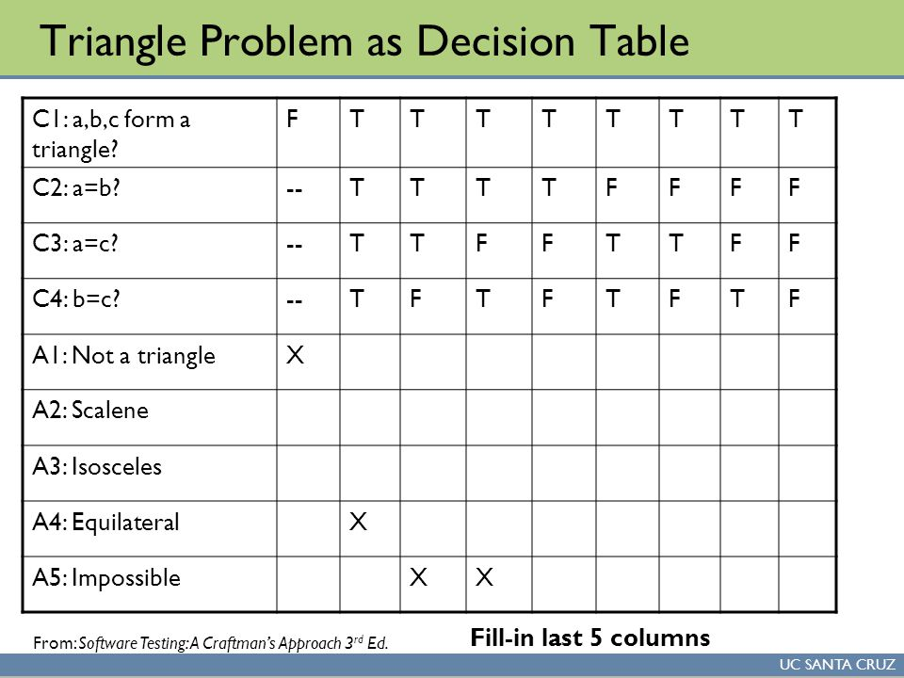

Slide 36
A decision table has following four portions
(a) Condition Stub : all the conditions are represented in the upper left section of the DT. These conditions are used to determine a particular action or set of actions. (b) Action Stub: All possible actions are listed in this lower left portion of the DT. (c) Condition Entries: In this condition entries portion of the DT. Values entered in this upper right portion of the table are known as inputs. (d) Action Entries: each entry in the action entries portion has some associated action or set of actions in this lower right portion of the table are known as outputs. They are dependent upon the functionality of the program.

Slide 37
Why is Decision Table Testing is important?
This testing technique becomes important when it is required to test different combination. It also helps in better test coverage for complex business logic.
In Software Engineering, boundary value and equivalent partition are other similar techniques used to ensure better coverage. They are used if the system shows the same behaviour for a large set of inputs. However, in a system where for each set of input values the system behaviour is different, boundary value and equivalent partitioning technique are not effective in ensuring good test coverage.
In this case, decision table testing is a good option. This technique can make sure of good coverage, and the representation is simple so that it is easy to interpret and use.
This table can be used as the reference for the requirement and for the functionality development since it is easy to understand and cover all the combinations.

Slide 38
Advantages of Decision Table Testing
When the system behaviour is different for different input and not same for a range of inputs, both equivalent partitioning, and boundary value analysis won't help, but decision table can be used.
The representation is simple so that it can be easily interpreted and is used for development and business as well.
This table will help to make effective combinations and can ensure a better coverage for testing
Any complex business conditions can be easily turned into decision tables
In a case we are going for 100% coverage typically when the input combinations are low, this technique can ensure the coverage.
Disadvantages of Decision Table Testing
The main disadvantage is that when the number of input increases the table will become more complex

Slide 39
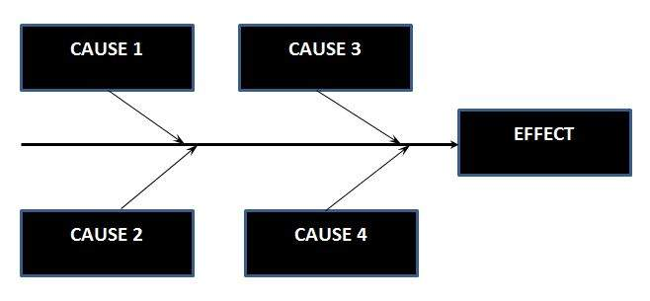
Cause Effect Graphing
Cause Effect Graph is a black box testing technique that graphically illustrates the relationship between a given outcome and all the factors that influence the outcome.
It is also known as Ishikawa diagram as it was invented by Kaoru Ishikawa or fish bone diagram because of the way it looks.
Cause Effect - Flow Diagram

Slide 40
Steps for drawing cause-Effect Diagram:
Step 1 : Identify and Define the Effect
Step 2 : Fill in the Effect Box and Draw the Spine
Step 3: Identify the main causes contributing to the effect being studied.
Step 4 : For each major branch, identify other specific factors which may be the causes of the EFFECT.
Step 5 : Categorize relative causes and provide detailed levels of causes.

Slide 41
Benefits :
It Helps us to determine the root causes of a problem or quality using a structured approach.
It Uses an orderly, easy-to-read format to diagram cause-and-effect relationships.
It Indicates possible causes of variation in a process.
It Identifies areas, where data should be collected for further study.
It Encourages team participation and utilizes the team knowledge of the process.
It Increases knowledge of the process by helping everyone to learn more about the factors at work and how they relate.

Slide 42
Path Testing
Path Testing is a structural testing method based on the source code or algorithm and NOT based on the specifications. It can be applied at different levels of granularity.
Path Testing Assumptions:
The Specifications are Accurate
The Data is defined and accessed properly
There are no defects that exist in the system other than those that affect control flow

Slide 43
Path Testing Techniques:
Control Flow Graph (CFG) - The Program is converted into Flow graphs by representing the code into nodes, regions and edges.
Decision to Decision path (D-D) - The CFG can be broken into various Decision to Decision paths and then collapsed into individual nodes.
Independent (basis) paths - Independent path is a path through a DD-path graph which cannot be reproduced from other paths by other methods.

Slide 44
DATA FLOW TESTING:
It focuses on the data variables and their values.
Data flow testing is the form of white box testing and structural type testing.

Slide 45
Types of perform data flow testing
Static Data Flow Testing : Study and analysis of code is done without performing the actual execution of the code.
Dynamic Data Flow Testing : It involves the execution of the code, to monitor and observe the intermediate results.

Slide 46
Slice based testing and program slicing tools:
The idea of slices is to separate a program into components that have some useful meaning.
We will include CONST declaration in slices.
Five forms of usage nodes: P – USE,C-USE,O-USE,L-USE,I-USE.
Two forms of definition nodes : I-def, A-def.

Slide 47
Tools :
Code surfer is a commercial tool for performing static slicing on C programming.
Indus is university research tool for doing static code slicing on Java.
Oberon Slicing Tool.

Slide 48
Limitations of data flow testing :
With the advantage of using the exploratory testing in the agile environment, some limitations are also associated with it such as:
Testers need to have sufficient knowledge of the programming.
Time – consuming and costly process.

Slide 49
REFERENCE :
Software Quality Assurance by Tech-Max Publication
Software Quality Assurance by SHETH Publication
Software Testing: Principles, Techniques and Tools by M. G. Limaye

